Slide 1


Java EE
(ADVANCE JAVA)
Lecture-5

Slide 2
Today’s Agenda
SQL -Database language.
Query –insert , update , delete.
Executing Non Select Queries From JDBC
Dynamic SQL
PreparedStatement

Slide 3
QUIZ
Q1. Which of the following is an Interface ?
A - DriverManager
B - OracleDriver
C - Connection
D - Class
Answer: C

Slide 4
QUIZ
Q2. How can you retrieve information from a ResultSet ?
A- By invoking the method get(String type) on the ResultSet, where type is the database type.
B- By invoking the special getter methods on the ResultSet called getString(...), getBoolean (...), getClob(...)
C- By invoking the method getValue(...), and cast the result to the desired Java type.
D-None of the above
Answer: B

Slide 5
QUIZ
Q3. Which of the following executes the any kind of SQL statement?
A - boolean run()
B - ResultSet executeQuery()
C - int executeUpdate()
D - None of the above.
Answer: D

Slide 6
QUIZ
Q4. What is the use of blob, clob datatypes in JDBC?
A - These are used to store large amount of data into database like images, movie etc which are extremely large in size.
B - These are used to store XML data.
C - Both of the above.
D - None of the above.
Answer: A

Slide 7
QUIZ
Q5. Resultset is an interface, how does it support rs.next()?
A - JDBC provides implementation of ResultSet & other interfaces
B - Every vendor of Database provides implementation of ResultSet & other interfaces, through the Driver.
C - No, ResultSet is a class so it has method body
D - None of the above.
Answer: B

Slide 8
QUIZ
Q6. Which of the following method can be used to create a Connection to the database?
A - getDBConnection(String url, String user, String password)
B - getConnection(String url)
C - getConnect(String url, String username,String password)
D - All of the above.
Answer: B

Slide 9
QUIZ
Q7. Which of the following class is used for executing SQL queries?
A- Statement
B- SQLStatement
C- DBStatement
D- None of the above
Answer: D

Slide 10
QUIZ
Q8 .Suppose that you have a table named animal with two rows. What is the result of the following code?
Connection conn = new Connection(url, userName, password); Statement stmt = conn.createStatement();
ResultSet rs = stmt.executeQuery("select count(*) from animal");
if (rs.next()) System.out.println(rs.getInt(1));
A - 0
B- 2
C- Compilation Error
D- SQLException
Answer: C

Slide 11
QUIZ
Q9. Which of the following is a valid JDBC URL?
A- jdbc:sybase:localhost:1234/db
B- jdbc::sybase::localhost::/db
C- jdbc::sybase:localhost::1234/db
D- sybase:localhost:1234/db
Answer: A

Slide 12
QUIZ
Q10. Which is the correct order in which to close database resources?
A- Connection, ResultSet, Statement
B- Connection, Statement, ResultSet
C- ResultSet, Connection, Statement
D- ResultSet, Statement, Connection
Answer: D

Slide 13
Introduction To SQL
SQL is a acronym of structured query language.
SQL is a universal language used by all the DBMS for interacting with the databases.
Important point to be noted is that SQL is case insensitive, which means SELECT and select have same meaning in SQL statements

Slide 14
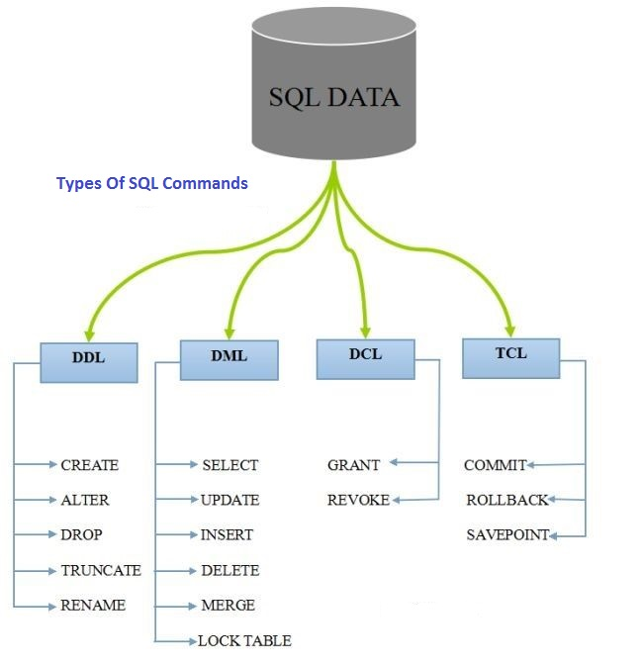
Types Of SQL Commands

Slide 15
BASIC QUERIES
INSERT:
Insert query is basically used to insert data in the database.
SYNTAX:
INSERT INTO table_name( column1, column2....columnN) VALUES ( value1, value2....valueN);
EXAMPLE:
INSERT INTO student (roll_no,name,city) VALUES(‘A101’,’Sama’,’Bhopal’);

Slide 16
UPDATE
UPDATE:
This query is use to change the existing data.
SYNTAX
UPDATE table_name SET column1 = value1, column2 = value2....columnN=valueN [ WHERE CONDITION ];
EXAMPLE:
Update student set name=‘ravi’ where roll_n0=‘A101’;

Slide 17
DELETE
DELETE:
Delete query is used to delete the existing table.
SYNTAX:
DELETE FROM table_name WHERE {CONDITION};
EXAMPLE:
Delete from student where roll_no=‘’A101’;

Slide 18
Executing Non Select Queries
In JDBC to execute non select queries we use the method executeUpdate( ) provided by the Statement interface.
The prototype of the method is :
public int executeUpdate(String sql) throws SQLException

Slide 19
Executing Non Select Queries
This method takes any non-select sql command as argument and returns the number of rows effected by that command.
There are 3 possible cases with return value:
1. >0 which means that atleast one row has been effected
2. =0 which menas none of the rows have been effected
3. =-1 which means that the query is DDL ( but this case is driver dependent)

Slide 20
Executing DELETE Query
String deleteStr =
"DELETE FROM employee " +
"WHERE lname = ‘Smith'";
Statement stmt = con.createStatement();
int delnum = stmt.executeUpdate(deleteStr);
executeUpdate is used for data manipulation: insert, delete, update, create table, etc. (anything other than querying!)
executeUpdate returns the number of rows modified

Slide 21
Dynamic SQL
The term dynamic SQL means an SQL query which contains dynamic values , i.e, the values are supplied at run time
For example , we want to insert records in the database by accepting values from the user.

Slide 22
Dynamic SQL
To solve this problem we have 2 options:
1. Use Statement object and create a dynamic sql query by using STRING CONCATENATION
2. Use PreparedStaement

Slide 23
Using String Concatenation
String qry= “insert into books values(”+id+ “,’ ” +bname + “ ‘ ,”+ price+ “ )” ;
The query above has been designed assuming that we have a table called books containing three columns for bookid,bookname and price .
The variables id , bname and price are java variables holding user input

Slide 24
Drawbacks Of String Concatenation
It is very difficult to write as we have manually insert single quotes
It is a programmer’s responsibility to handle date conversions
It is prone to a very famous sql attack called SQL INJECTION

Slide 25
PreparedStatement
The PreparedStatement interface extends the Statement interface which gives us added functionality with a couple of advantages over a generic Statement object.
This statement gives us the flexibility of supplying arguments dynamically.

Slide 26
PreparedStatement
PreparedStatement object is created using prepareStatement ( ) in Connection interface.
PreparedStatement pst = null;
String SQL = “Insert into books values(? ,? ,?)”;
pst = conn.prepareStatement(SQL);
All parameters in JDBC are represented by the ? symbol, which is known as the placeholder
We must supply values for every placeholder before executing the SQL statement.

Slide 27
setXXX( ) methods
The setXXX( ) methods bind values to the parameters, where XXX represents the Java data type of the value you wish to bind to the input parameter. If you forget to supply the values, you will receive a SQLException.
setXXX( ) method takes two arguments representing position of placeholder (?) and value to replace respectively.
Each placeholder is referred to by its ordinal position.
The first placeholder represents position 1, the next position 2, and so forth.
pst.setInt(1, 101);
pst.setString(2,”JEE Applications”);
pst.setDouble(3,500.0);

Slide 28
Querying with PreparedStatement
String queryStr =
"SELECT * FROM employee " +
"WHERE empno= ? and salary > ?";
PreparedStatement pstmt = con.prepareStatement(queryStr);
pstmt.setInt(1, 784);
pstmt.setInt(2, 26000);
ResultSet rs = pstmt.executeQuery();

Slide 29
Updating with PreparedStatement
String deleteStr =
“DELETE FROM employee " +
"WHERE empno = ?”;
PreparedStatement pstmt = con.prepareStatement(deleteStr);
pstmt.setInt(1, 26000.0);
int delnum = pstmt.executeUpdate();

Slide 30
Statements vs. PreparedStatements: Be Careful!
Are these the same? What do they do?
String val = "abc";
PreparedStatement pstmt = con.prepareStatement("select * from R where A=?");
pstmt.setString(1, val);
ResultSet rs = pstmt.executeQuery();
String val = "abc";
Statement stmt = con.createStatement( );
ResultSet rs =
stmt.executeQuery("select * from R where A=" + val);

Slide 31
Statement V/s PreparedStatement
Statement | PreparedStatement
It is used to execute normal SQL queries. | It is used to execute parameterized or dynamic SQL queries.
It is preferred when a particular SQL query is to be executed only once. | It is preferred when a particular query is to be executed multiple times.
You cannot pass the parameters to SQL query using this interface. | You can pass the parameters to SQL query at run time using this interface.
This interface is mainly used for DDL statements like CREATE, ALTER, DROP etc. | It is used for any kind of SQL queries which are to be executed multiple times.
The performance of this interface is very low. | The performance of this interface is better than the Statement interface (when used for multiple execution of same query).

Slide 32
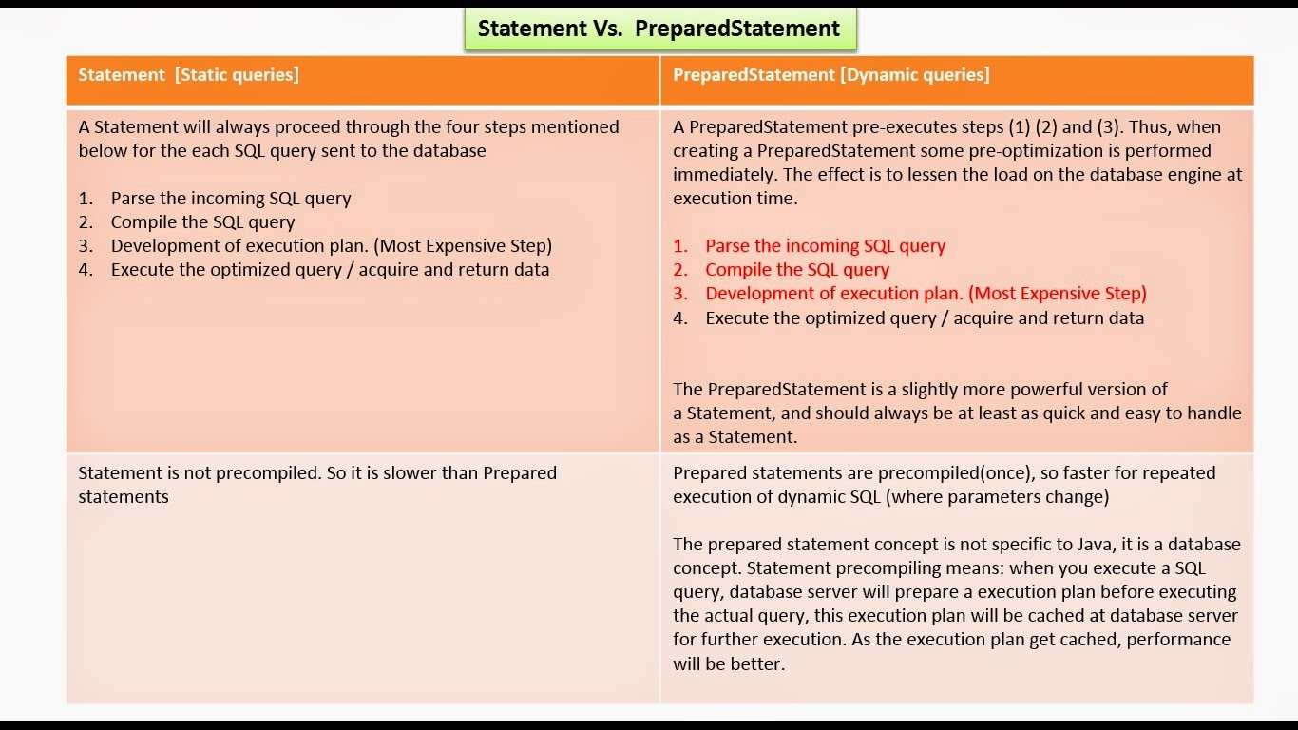
Statement V/s PreparedStatement

Slide 33
QUESTION!!!
Will this work?
No!!! A ‘?’ can only be used to represent a column value
PreparedStatement pstmt = conn.prepareStatement("select * from ?");
pstmt.setString(1, str); // assume str is a string holding table name

Slide 34

End Of Lecture
For any queries mail us @: scalive4u@gmail.com
Call us @ : 0755-4271659, 7879165533
Agenda for Next Lecture:
CallableStatement
Introduction to PL-SQL

